Slide 1
Convolution-based image filters
Boiangiu Victor-Miron
Irimia Marian

Slide 2
Introduction
What is Gaussian Blur?
Project Overview
Is an image processing technique
Applies a Gaussian function to an image, effectively smoothing it.
It reduces noise and detail by averaging pixel values.
We compare performance using different approaches :
MPI
Pthreads
MPI & Pthreads

Slide 3
How it works

Slide 4
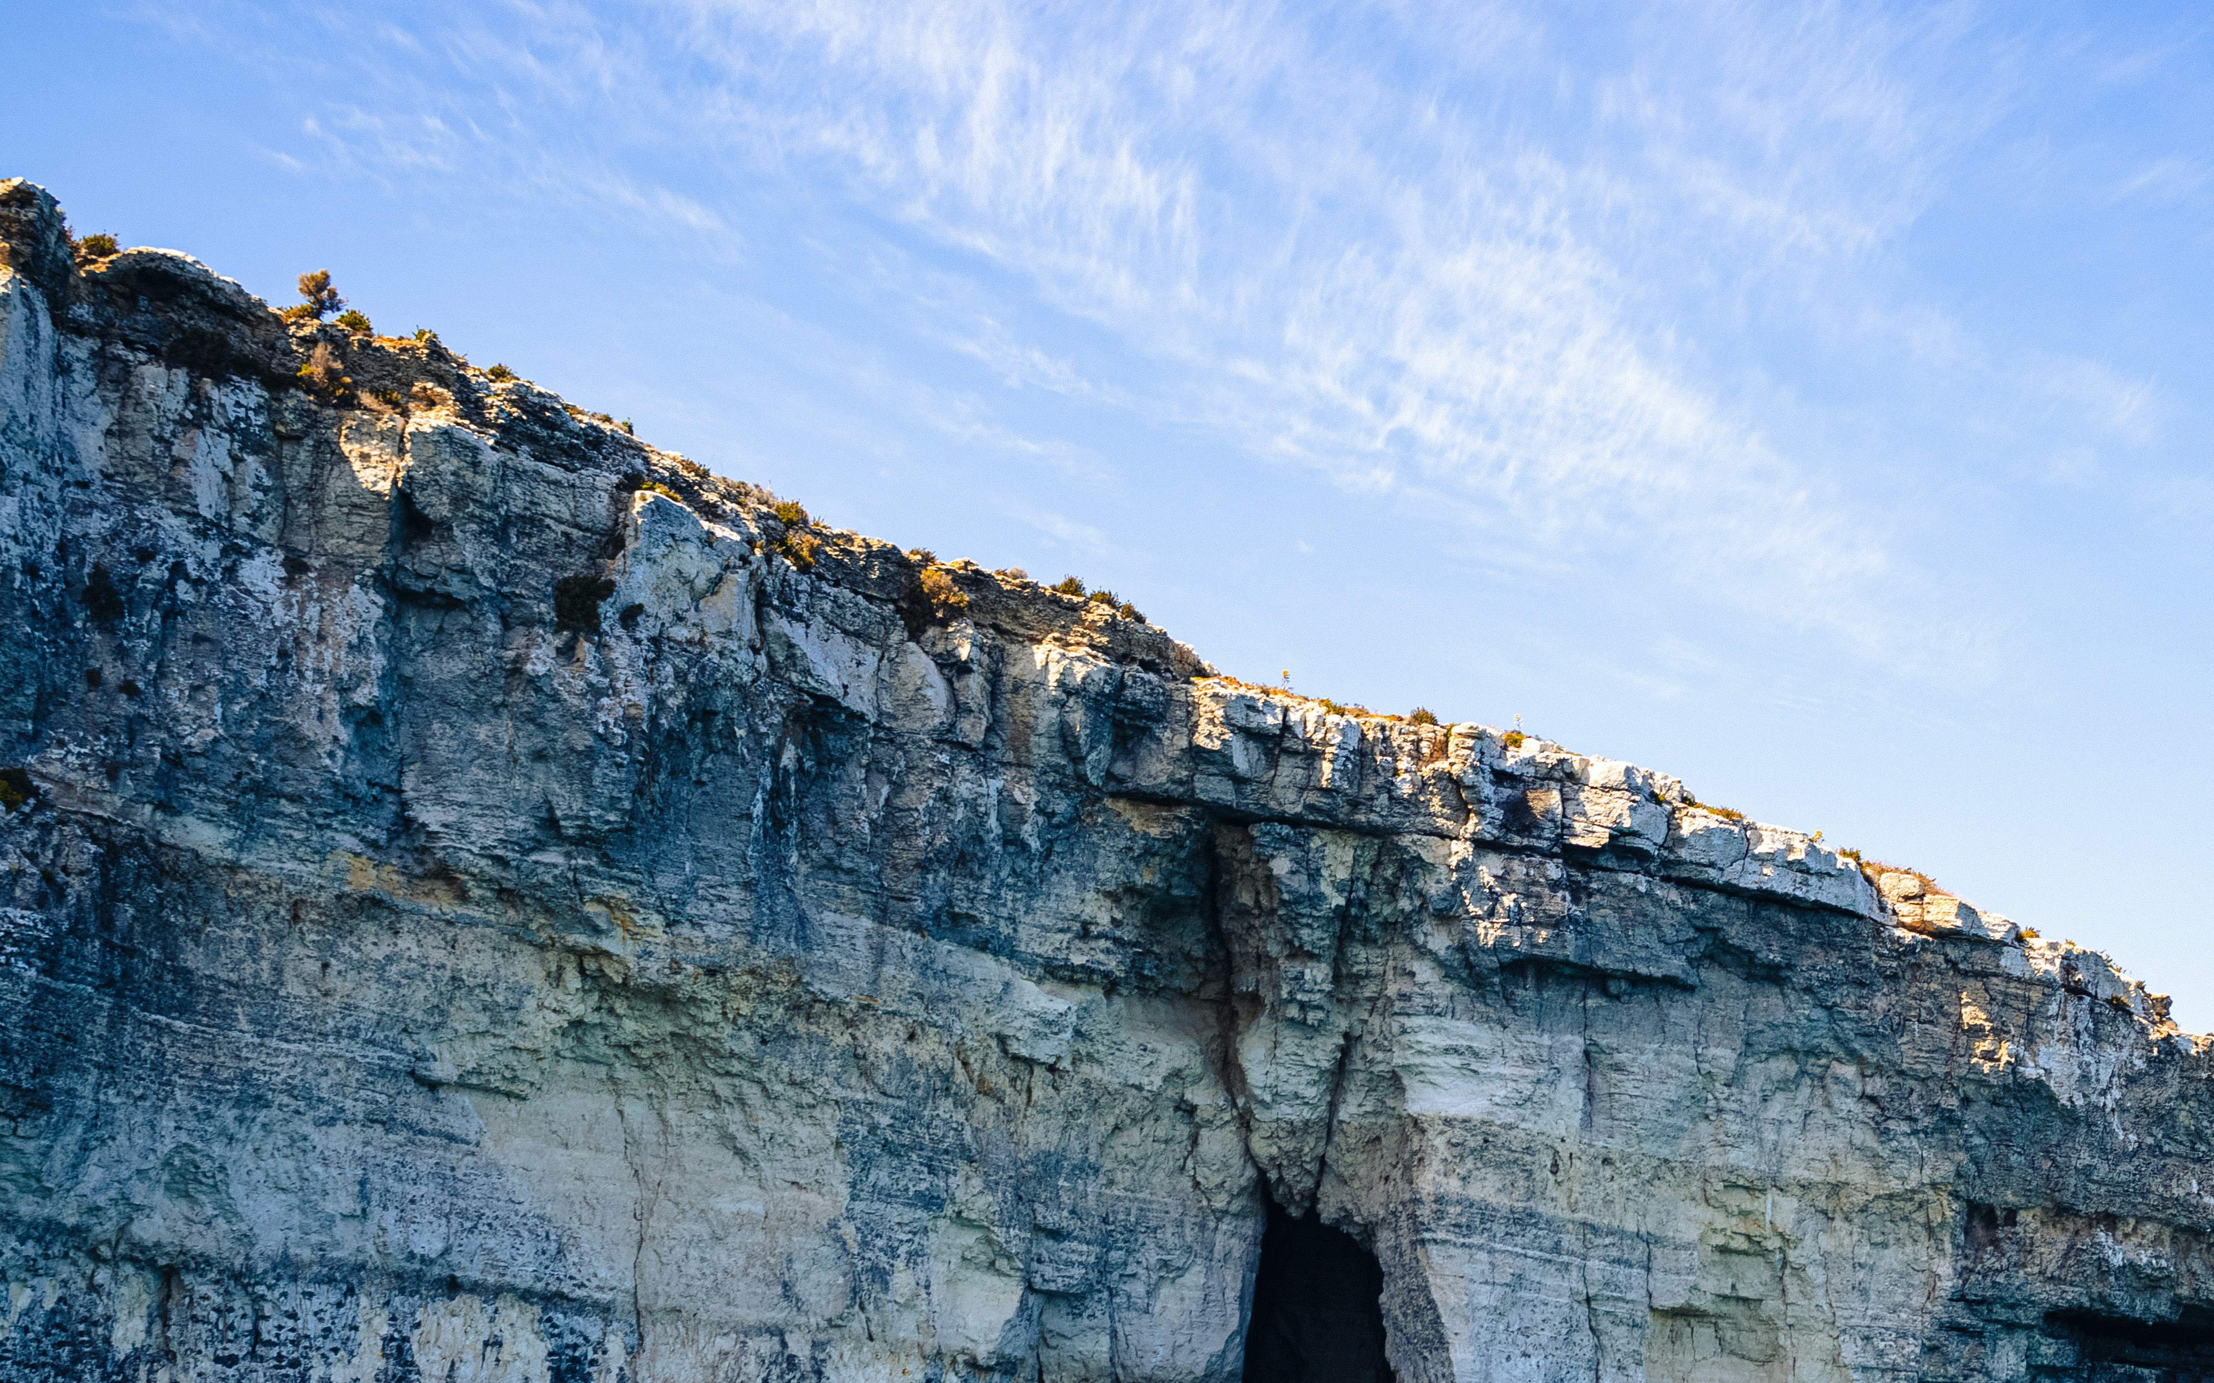
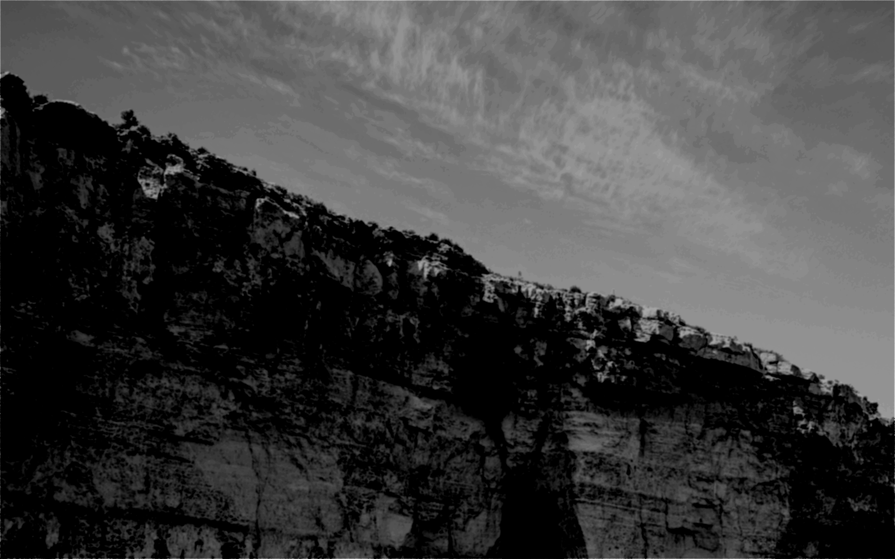
Example

Slide 5
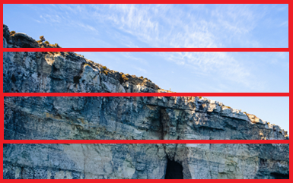
MPI
How it works
Problems
Each instance (process) is launched with MPI and can identify itself by rank (0, 1, 2, etc.).
The image’s rows are split evenly across all ranks.
After computing its portion, each process sends the final rows back to a master process (rank 0).
We expanded the row range slightly (10 rows).
Without this, a process would lack neighbor pixels and produce edge artifacts (visible lines where chunks meet).
Process 1
Process 2
Process 3
Process 4

Slide 6
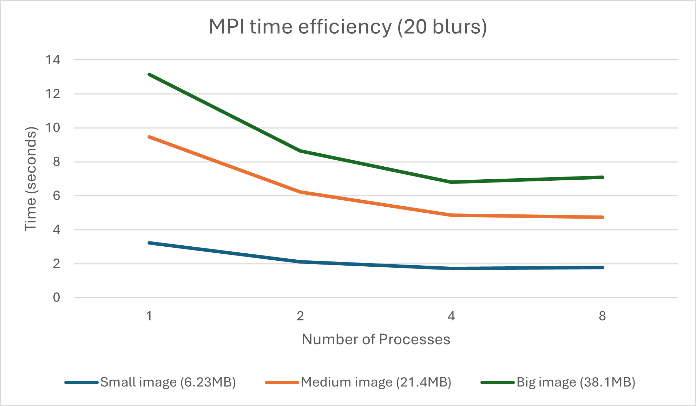
MPI results
Maximum Speedup:. 2.89 (8 processes)
Maximum Efficiency: 0.36 (8 processes)

Slide 7

Pthreads
How it works
Problems
We used pthread_create to spawn a certain number of threads, each receiving parameters about which rows to handle.
Each thread is assigned a subset of rows to blur.
We introduced a pthread_barrier_t, which threads must reach after applying the blur before they can move on to copying results.
The barrier ensures no thread overwrites data that another thread hasn’t finished processing, thus avoiding artifacts.
Thread 1
Thread 2
Thread 3
Thread 4

Slide 8
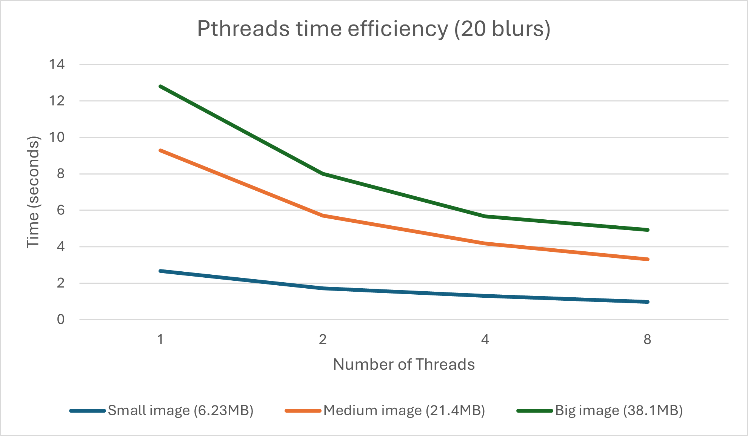
Pthreads results
Maximum Speedup:. 4.15 (8 threads)
Maximum Efficiency: 0.52 (8 threads)

Slide 9

MPI + PThreads
How it works
Problems
Each rank (process) handles a portion of the image’s rows.
Each thread receives parameters about which part of the process’s rows it handles.
Inside each process, threads use pthread_barrier_t to ensure they all finish computing the blurred values before copying back to the main image buffer.
Once the threads finish, rank 0 gathers rows from other ranks via MPI_Recv.
Threads still rely on expanded row ranges to handle blur edges correctly.

Slide 10
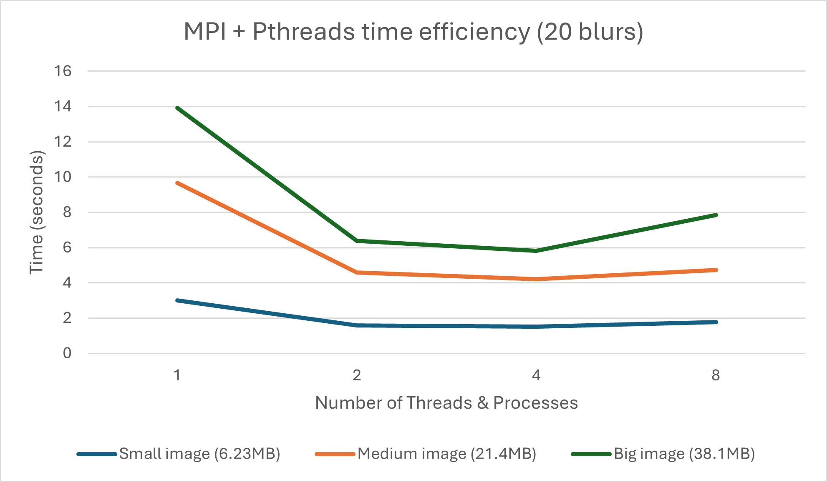
MPI + Pthreads results
Maximum Speedup:. 3.26 (4 threads & processes)
Maximum Efficiency: 0.82 (4 threads & processes)
.

Slide 11
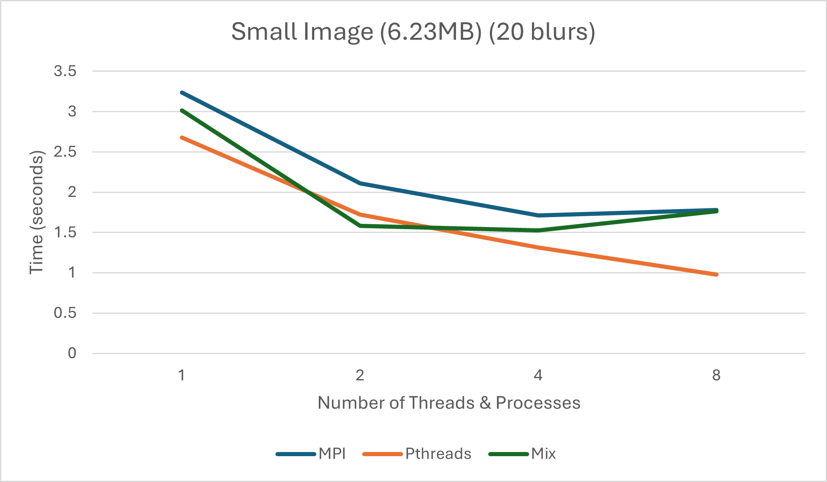
Comparisons

Slide 12
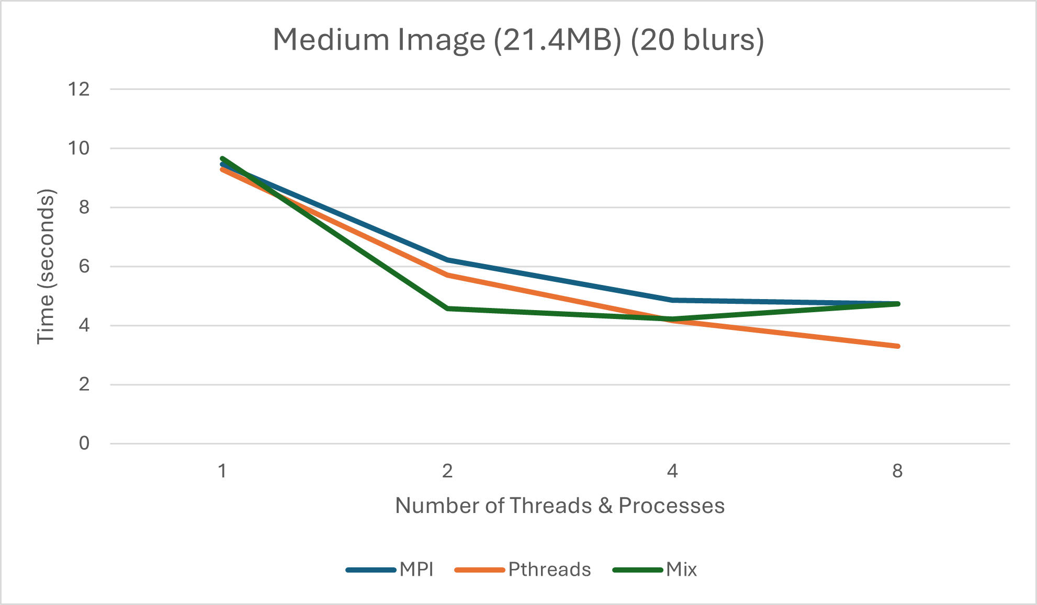
Comparisons

Slide 13
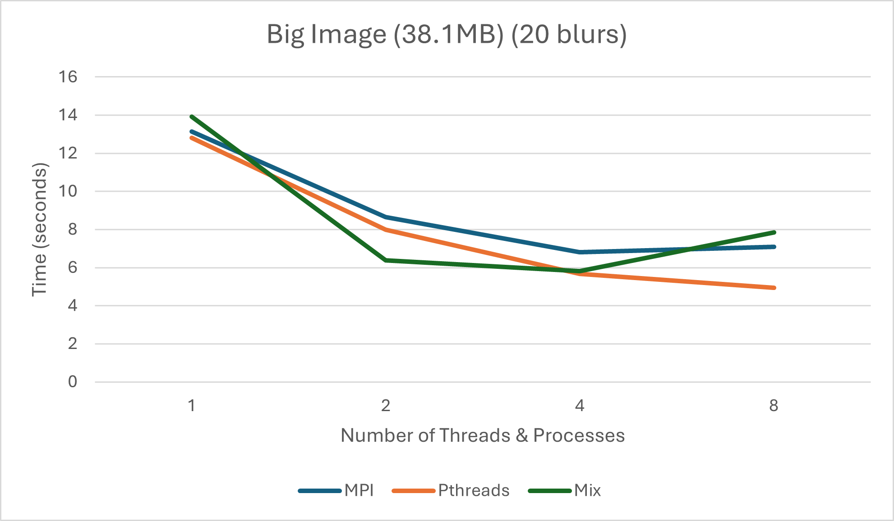
Comparisons

Slide 14
Thank you for your attention!

